Slide 1


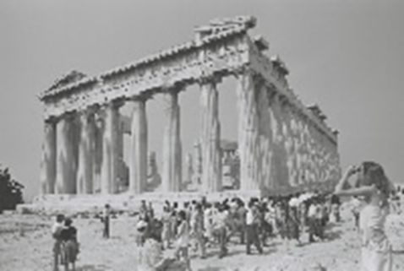
H2020
Societal Challenge 6:
Europe in a changing world
Inclusive, innovative & reflective societies
Corinna AMTING
Research Executive Agency
Brussels, 11/03/2016
societies

Slide 2
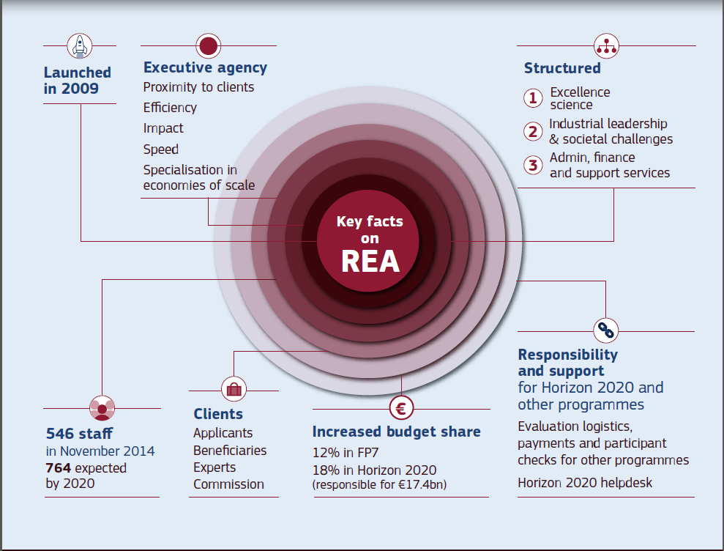
Research Executive Agency (REA)

Slide 3
REA +
DG Research
European Commission
DG Research
- Definition of policies
- Drafting of Work Programme
Research Executive
Agency
- Implementation of calls for proposals
- Management of funded projects

Slide 4
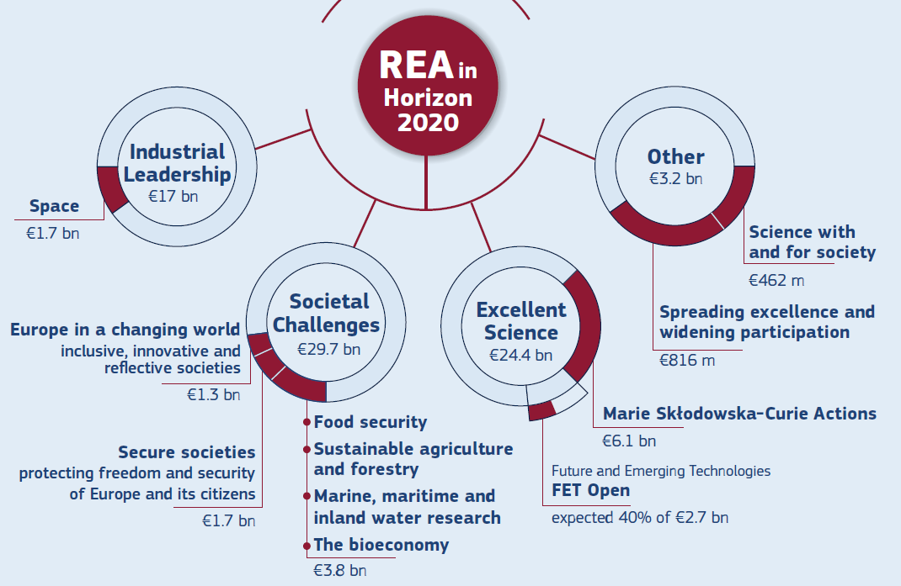
REA & Societal Challenge 6

Slide 5
Work Programme -
elaboration
Bi-annual Work Programme (WP):
  2016/17 – published, topics open
  2018/19 – under preparation
WP elaborated in a complex process (followed by stocktaking) managed by DG Research & Innovation and DG CONNECT, involving ~13 policy DGs, Expert Advisory Group, Programme Committee, research communities

Slide 6

Societal
Challenge 6
Inclusive Societies
Smart, sustainable and inclusive growth
Building resilient, inclusive, participatory, open and creative societies in Europe
Europe's role as a global actor
Sustainable and inclusive environments through innovative spatial and urban
planning and design

Slide 7
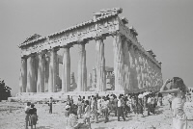
Societal
Challenge 6
Reflective societies –
cultural heritage and European identity
European heritage (memory, identity)
European countries’ and regions’ history, literature, art, philosophy and religions and how these have informed contemporary European diversity
Research on Europe's role in the world – intercultural relations

Slide 8
Innovative societies
Societal
Challenge 6
Strengthening the evidence-base and support for the IU and ERA
Explore new forms of innovation, with
special emphasis on social innovation
and creativity
Make use of the innovative, creative
and productive potential of all
generations
Cooperation with third countries

Slide 9
SC6 –
2014 - 2016 Calls
Country distribution of participants

Slide 10
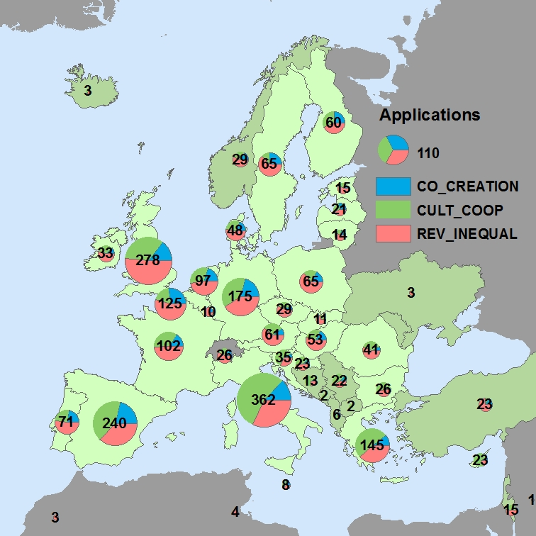
Country distribution of participants
SC6 – 2016 Calls
2413 participants (incl. doubles)
Member States - 28:
2236 participations (93%)
Associated Countries - 9: 105 participations (4%)
Third Countries - 17:
72 participations (3%)
Participations per call:
CO-CREATION: 400 (17%)
CULT-COOP: 902 (37%)
REV-INEQUAL: 1111 (46%)

Slide 11
Overview of evaluation process
Evaluators
Receipt of
proposals
Individual
evaluation
Consensus
group
Panel
Review
Finalisation
Eligibility check
Allocation of proposals to evaluators
Individual
Evaluation
Reports
(Usually done remotely)
Consensus
Report
(May be done
remotely)
Panel
ranked list
Evaluation
Summary
Reports

Slide 12
Societal
Challenge 6
Experts and Monitors

Slide 13
SC6 –
2016 & 2017 Calls
Work Programme information
4 Calls and 39 Topics for 2016 and 2017
Co-creation for growth and inclusion
Reversing inequalities and promoting fairness
Engaging together globally
Understanding Europe – promoting the European public and cultural space
Fast track to innovation
SME instrument
Other Actions to support ERA and IU

Slide 14
SC6 –
2016 & 2017 Calls
Calls and budgets
Societal Challenge 6
 | 2016 | 2017 | total
CO-CREATION | € 23.5 | € 33.2 | € 56.65
REV-INEQUAL | € 43.5 | € 3.0 | € 46.5
ENG-GLOBALLY | € 11.5 | € 30.5 | € 42
CULT-COOP | € 19.5 | € 47.5 | € 67
Notes:
MSCA: 8% of total H2020 budget

Slide 15
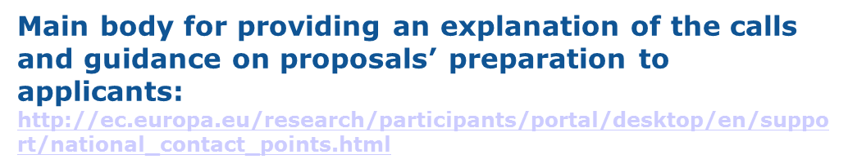

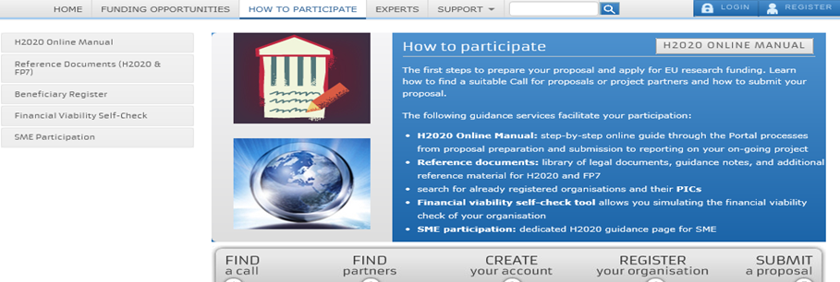
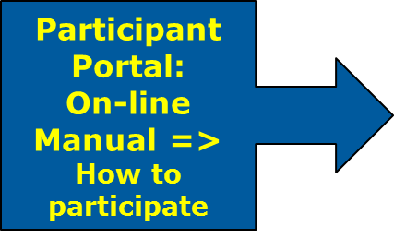

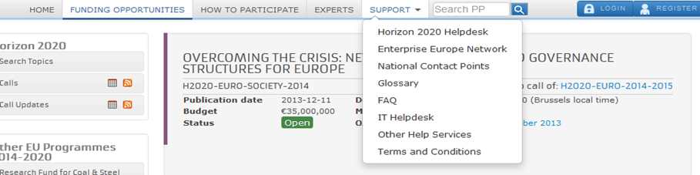
H2020 calls – guidance & support

Slide 16
Societal
Challenge 6
Annex:
calls overview and examples

Slide 17
Societal
Challenge 6
Engaging together globally
ENG-GLOBALLY-01-2017 | Strengthening Europe's position in the global context: science diplomacy and intercultural relations
ENG-GLOBALLY-02-2017 | Shifting global geopolitics and Europe's preparedness for managing risks, mitigation actions and fostering peace
ENG-GLOBALLY-03-2017 | The European Union and the global challenge of migration
ENG-GLOBALLY-04-2017 | Science diplomacy for EU neighbourhood policies
ENG-GLOBALLY-05-2017 | The strategic potential of EU external trade policy
ENG-GLOBALLY-06-2017 | The Asia-Pacific as a strategic region for Europe
ENG-GLOBALLY-07-2017 | The European Union and Central Asia
ENG-GLOBALLY-08-2016/17 | EU-China cooperation on sustainable urbanisation
ENG-GLOBALLY-09-2016 | Centres/Networks of European research and innovation

Slide 18
Engaging together globally
Example
ENG-GLOBALLY-02-2017
Shifting global geopolitics & Europe's preparedness for managing risks, mitigation actions and fostering peace
Long-term transformations challenging the traditional predominance of the West and Union's capacity for guaranteeing its citizens' security:
Recent global geopolitical developments and their implications for the European Union
European Union's preparedness for managing risks and opportunities, fostering peace in a crisis-ridden context
RIA – 2017: € 5 M

Slide 19
Engaging together globally
Example
ENG-GLOBALLY-04-2017
Science diplomacy for EU neighborhood policies
Consolidated the corpus of knowledge on science diplomacy in service of the European Neighborhood Policy
Feed into future EU strategies vis-à-vis its neighbors
Wide dissemination of these results to the relevant stakeholders
CSA – 2017: € 1.5 M

Slide 20
Engaging together globally
Example
ENG-GLOBALLY-09-2016
Centres / Networks of European R&I
Establish new centres for support, promotion and awareness raising on European science, technology and innovation
Reinforce the presence of European research and innovation actors in selected international partner countries and regions
Stronger presence and visibility of EU organisations in the science and innovation environment of the partner country
Improved framework conditions for international cooperation in R&I and enhanced impact of results from R&I projects
CSA - 2016: € 10 M

Slide 21
Societal
Challenge 6
Reversing inequalities and promoting fairness
REV-INEQUAL-01-2016 | An empirically informed European theory of justice and fairness
REV-INEQUAL-02-2016 | Contemporary radicalisation trends and their implications for Europe
REV-INEQUAL-03-2016 | Dynamics of inequalities across the life-course
REV-INEQUAL-04-2016 | Intra-EU mobility and its impacts for social and economic systems
REV-INEQUAL-05-2016 | Inequalities in the EU and their consequences for democracy, social cohesion and inclusion
REV-INEQUAL-06-2016 | Tackling inequalities at their roots: new policies for fairness in education from early age
REV-INEQUAL-07-2016 | Spatial justice, social cohesion and territorial inequalities
REV-INEQUAL-08-2016 | Fighting inequalities through policies against tax fraud and tax evasion
REV-INEQUAL-09-2017 | Boosting inclusiveness of ICT-enabled research and innovation
REV-INEQUAL-10-2016 | Multi-stakeholder platform for enhancing youth digital opportunities

Slide 22
Reversing inequalities
and promoting fairness
Example
REV-INEQUAL-02-2016
Contemporary radicalization trends and their implications for Europe
Enhance the knowledge base on the scope, origins, causes and dynamics of radicalisation, in particular in relation to young people
Evaluating policies with regard to their effects on radicalisation and (dis)integration. Recommendations on how to address religious fundamentalism in and outside of Europe in particular
Projects will produce profiles of recruiters and targeted individuals
a) Radicalisation, violence and hate crime
b) Radicalisation and religious fundamentalism
RIA – 2016: € 5 M

Slide 23
Reversing inequalities
and promoting fairness
Example
REV-INEQUAL-03-2016
Dynamics of inequalities across the life-course
Underlying mechanisms, structures and processes of inequality across life-courses and between generations
Understanding most pressing problems related to inequality and social cohesion
Engaging, bringing together and broadening the research community (north, south, east and west)
Comparative and multi-disciplinary research (sociology, education, law, political science, economics, history, anthropology and psychology, demography and sustainability)
ERA-NET Cofund – 2016: € 5 M

Slide 24
Societal
Challenge 6
Understanding Europe -
promoting the European public and cultural space
CULT-COOP-01-2017 | Democratic discourses and the rule of law
CULT-COOP-02-2017 | Improving mutual understanding among Europeans by working through troubled pasts
CULT-COOP-03-2017 | Cultural literacy of young generations in Europe
CULT-COOP-04-2017 | Contemporary histories of Europe in artistic and creative practices
CULT-COOP-05-2017 | Religious diversity in Europe - past, present and future
CULT-COOP-06-2017 | Participatory approaches and social innovation in culture
CULT-COOP-07-2017 | Cultural heritage of European coastal and maritime regions
CULT-COOP-08-2016 | Virtual museums and social platform on European digital heritage, memory, identity and cultural interaction
CULT-COOP-09-2017 | European cultural heritage, access and analysis for a richer interpretation of the past
CULT-COOP-10-2017 | Culture, integration and European public space
CULT-COOP-11-2016/17 | Understanding the transformation of European public administrations

Slide 25
Understanding
Europe
Example
CULT-COOP-04-2017
Contemporary histories of Europe in artistic and creative practices
Investigate the evolving representations of Europe in contemporary artistic expressions
Better knowledge of cultural Europeanization in the making
Renewal of a non-elitist cultural narrative of Europe that speaks to Europeans of different languages, cultures, religions and origins beyond national borders
Enhanced cultural inter-comprehension among Europeans, especially young Europeans
New teaching materials for formal and informal education
RIA – 2017: € 2.5 M

Slide 26
Understanding
Europe
Example
CULT-COOP-05-2017
Religious diversity in Europe - past, present and future
Analyse the co-existence of religious communities in Europe and repercussions for the European public and cultural space
Historical and comparative perspective enabling European citizens to better grasp conditions needed for religious coexistence in Europe
Innovative dissemination tools for education purposes (history, political science, civic education)
Policy recommendations and dissemination to the media for future strategies of cooperation with religious communities and in coping with anti-religious animosity
RIA – 2017: € 2.5 M

Slide 27
Thank you!

