Slide 1

Making innovation happen!
The EIT at a glance
9 June 2015, Steering Meeting Western Balkan Countries

Slide 2

European Institute of Innovation and Technology
Our vision is to become the leading European initiative that empowers innovators and entrepreneurs to develop world-class solutions to societal challenges, and create growth and skilled jobs.
Our mission is to:
Contribute to the competiveness of Europe and its sustainable economic growth by promoting and strengthening synergies and cooperation between businesses, education institutions and research organisations.
We aim to create favourable environments for creative thoughts, in order to enable world-class innovation and entrepreneurship to thrive in Europe.
Notes:
WHO is the EIT and what does it do?

Slide 3

Our strategy to
boost innovation in Europe
Facilitate the development of European ecosystems where research, business and education come together to find sustainable solutions to societal challenges by:
Creating interconnected knowledge and creativity hotspots
Fostering talent: entrepreneurs and students
Attracting investors

Slide 4
European Institute of Innovation and Technology
The EIT is the first EU initiative bringing together the three sides of the “knowledge triangle”: business (companies and SMEs), education institutions and research centres.
The EIT aims to increase the cooperation and integration between higher education, business and research to facilitate the transition from:
student to entrepreneur
idea to product
lab to customer
Notes:
The EIT is an EU body that enhances Europe’s ability to innovate by nurturing young entrepreneurial talent and supporting new ideas through the Knowledge and Innovation Communities (KICs).

Slide 5

The European innovation paradox
Excellent European research base, dynamic companies and creative talent
Good ideas are too rarely turned into
new products or services!
Notes:
Not working together effectively in a systematic way (some good practices, but not mainstreamed)

Slide 6
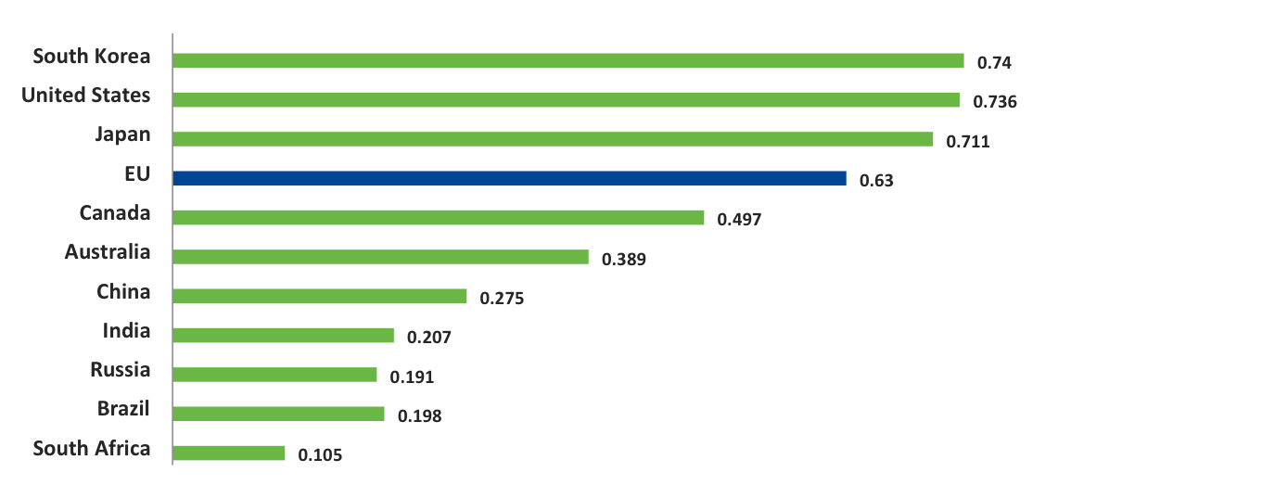
How does Europe compare globally?
Global innovation performance
Innovation Union Scoreboard 2014 – European Commission

Slide 7
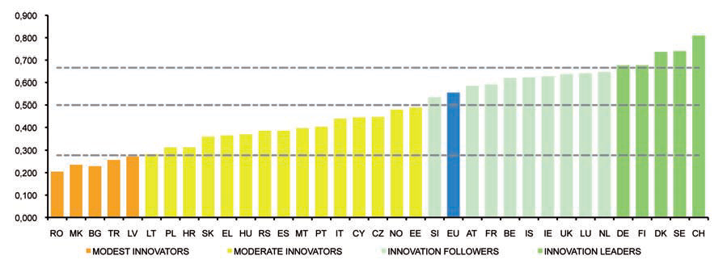
Innovation performance in Europe
Non-EU countries include Switzerland (CH), Iceland (IS), Norway (NO), Serbia (RS), Former Yugoslav Republic of
Macedonia (MK) and Turkey (TR).
Innovation Union Scoreboard 2015 – European Commission
Notes:
WHY is increasing the EU’s Member States innovation capacity so important?
However, whilst the EU has been closing the innovation gap with the United States and Japan, it is also important to remember that as an EU body, the EIT must also contribute to the increased innovation capacity of the EU’s 28 Member States, not the Union as a whole.
As you can see in this graph, there are still significant differences in the innovation performances of the various EU Member States. The good news is that these differences are become smaller again although at a modest rate and we must strive to keep on decreasing these differences. And increasing the innovation performance of Member States will make the EU more innovative as whole increasing our competitiveness.
Important to mention that this is Innovation Performance is measured as the sum of 25 input and infrastructure/process indicators – and is NOT a measure of the same countries’ performance on GDP/economic growth and job creation. Therefore, communication-wise, it could be interesting to illustrate this graphically – that this is a first necessary step describing ‘readiness’ rather than performance – and that what we are doing with EIT and our KICs etc. is to (1) further develop readiness (especially on human capital with entrepeneurial mindset) and (2) building partnerships, competences and capabilities necessary to bridge readiness with performance. Suggesting also to include on slide the 4 ‘categories’ (Innovation leaders, followers and moderate/modest innovators).
Serbia performs very well in Youth education, Non-R&D innovation expenditures and Employment in knowledge-intensive activities, and Serbia’s innovation performance has been improving rapidly at an average annual growth
rate of 6.3%.
The Former Yugoslav Republic of Macedonia and Turkey are Modest innovators. The Former Yugoslav Republic of Macedonia is performing well above average in Non-R&D innovation expenditures and SMEs with product or process innovations, and its growth performance (3.7%) has been well above that of the EU. Turkey is performing strongly in Non- R&D innovation expenditures and Sales due to new innovative products. Turkey’s growth rate at 7.0% is significantly above that of the EU.

Slide 8
A unique offering: what we do
Education
For creativity & innovation
High quality EIT labelled degree
Entrepreneurship
Business creation & acceleration
Promoting a new mindset and culture
Innovation
Connected ecosystems across European borders, exploiting synergies and complementarities

Slide 9

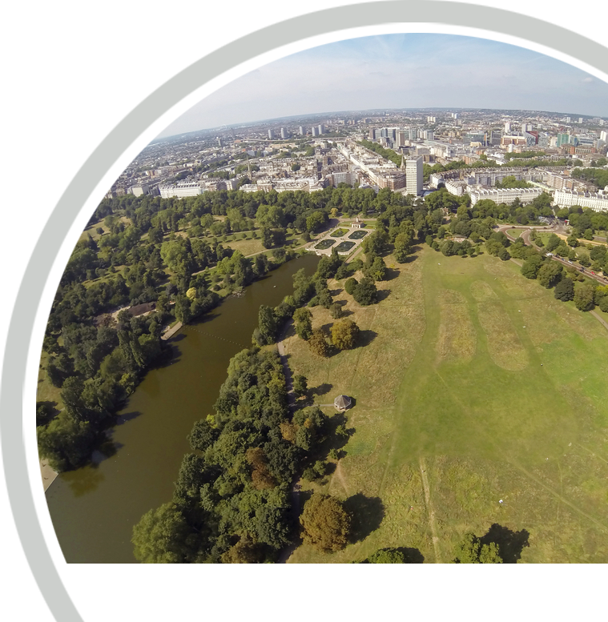
Innovation project – Making cities more livable in view of climate change
The knowledge triangle in action
  Imperial College London
  Aecom
  Alterra – Wageningen UR
  ARCADIS
  Bosch Slabbers
  Deltares
  Ecole des Ponts et Chaussee (ENPC)
  ICCI Ltd.
  Ingenieurgesellschaft Prof Dr Sieker mbH
  Institute of Sustainability
  Sainsbury’s
  Studio Exter
  Technische Universitat Berlin (TU Berlin)
  Delft University of Technology (TU Delft)
  Veolia Environnement
A cooperation between higher education, research organisations, SMEs, a charity and large companies

Slide 10

Knowledge and Innovation Communities
The EIT’s KICs are:
Thematic innovation communities that develop innovative products and services, foster new business , encourage growth and nurture young entrepreneurial talent
Characterised by a high degree of integration, a long-term perspective, efficient governance, the co-location model and the entrepreneurial culture
Unique partnerships that increase Europe’s capacity for innovation by bringing together leading companies, universities and research labs
Able to react to new challenges and changing environments in an effective and flexible way
Driven by a pursuit of excellence

Slide 11

The KIC model
A business logic
High degree of integration: each KIC is an independent legal entity, gathering world-class partners from across the knowledge triangle based on a contractual relationship/partnership with the EIT.
Long-term strategic approach: each KIC is set up for a minimum of 7 years to eventually become sustainable.
Autonomy and flexibility: to determine organisational structure and activities governed by a Board of KIC partner organisations.
Effective governance: run by a CEO and a lean management team at central and co-location centre level.

Slide 12



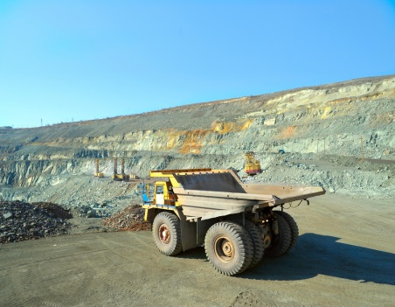

EIT’s first 3 KICs – designated in December 2009
Climate-KIC
EIT Digital
KIC InnoEnergy
EIT’s 2 new KICs – designated in December 2014
EIT Raw Materials
EIT Health
Notes:
To date, our three KICs address climate change, ICT and sustainable energy. At the end of 2014, we selected two new KICs for raw materials and healthy living and active ageing. By 2020, we foresee that the EIT will have eight KICs up and delivering, thus considerably increasing our impact on the European innovation landscape.

Slide 13

EIT priorities 2014 – 2020
1
2
3
Fostering
Creating
Sharing and
Disseminating
growth and impact of first 3 KICS
5 new KICs
EIT Health
EIT Raw Materials
EIT Food
EIT Manufacturing
EIT Urban Mobility
EIT good practices
2014
Climate-KIC
EIT Digital
KIC InnoEnergy
2016
2018

Slide 14
The KIC model
an investment logic
Smart funding & high degree of commitment of partners: EIT funding to KICs is max. 25% of their total budget over time with 75% to be attracted from other sources, both public and private.
Culture: KICs are shaped by strong entrepreneurial mindsets and cultures.
The co-location model: each KIC consists of 5-7 world class innovation hotspots building and leveraging on existing European capacities.
Results & high impact oriented activities: KICs implement a Business Plan with measurable deliverables, results and impact.

Slide 15
EIT across Europe: KICs’ Co-location Centres
Climate-KIC
  Co-location Centre
  Regional Centre (RIC)
  Co-location Centre
  Co-location Centre
  Associate Partner
  Co-location Centre
  Co-location Centre
EIT Health
EIT ICT Labs
EIT Raw Materials
KIC InnoEnergy
Notes:
Climate-KIC:
Co-location centres: France (Paris), Germany (Berlin), The Netherlands (Utrecht), Switzerland (Zurich), United Kingdom (London), Nordic centre (Denmark, Lyngby)
RICs: Valencia (Spain), Central Hungary, Emilia Romagna (Italy), Lower Silesia (Poland), Hessen (Germany), West Midlands (UK)
EIT Digital:
Co-location centres: Berlin (Germany), Eindhoven (The Netherlands), Helsinki (Finnland), London (UK), Paris (France), Stockholm (Sweden), Trento (Italy)
Associate partners: Madrid (Spain), Budapest (Hungary)
KIC InnoEnergy:
Co-location centres: Benelux (Eindhoven, The Netherlands); France (Grenoble); Germany (Karlsruhe); Iberia (Barcelona); Poland Plus (Krakow); Sweden (Stockholm)

Slide 16
Overview of KIC partners
Today, the first three KICs bring together more than 760 partners:
Figures – February 2015
Notes:
[Source: SharePoint Partners List – February 2015]

Slide 17
Leveraging and pooling resources
+
=
EIT
Funding
(max 25%)
Non-EIT
Funding
(max 75%)
Total KIC
funding
(max 100%)
  Combing EIT and non-EIT funding to:
  Ensure long-term involvement of KIC partners
  Incentivise financial commitment from KIC partners
  Provide a catalyst for investment in innovation

Slide 18
EIT Community: first achievements
Climate-KIC, EIT Digital and KIC InnoEnergy have grown into thriving European innovation hubs:
24,162
1028
1141
Attractiveness of education
programmes – more than
13 applicants per offered seat
number of graduates
number of business
ideas incubated
205
558
280
number of start-ups created
number of knowledge transfers/adoption
number of new or improved
products, services and processes launched
Figures – February 2015
Inc. forecast 2015
Notes:
Cumulated data; including data from business plans 2015

Slide 19
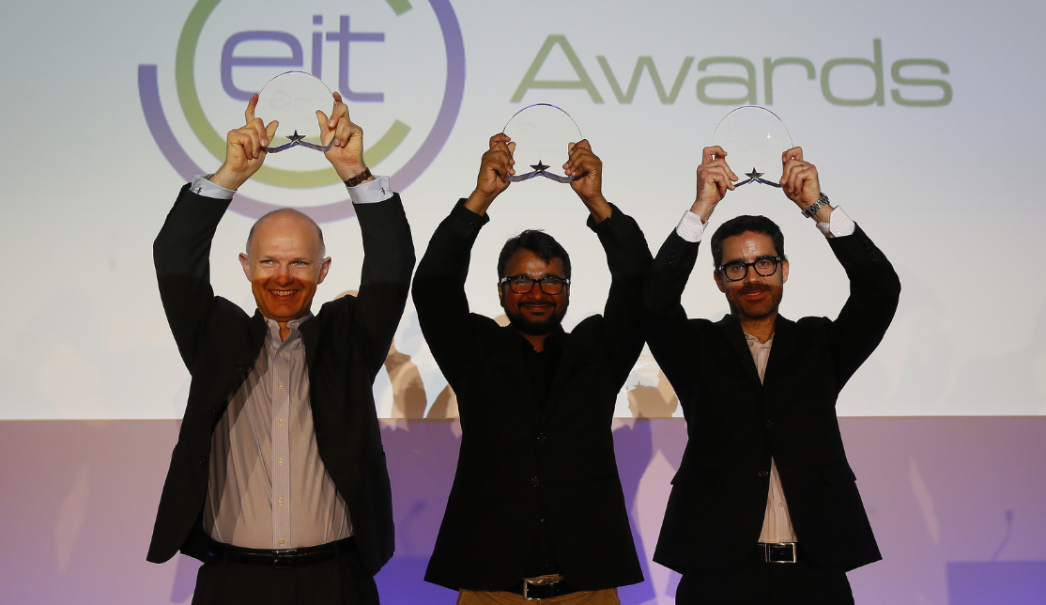
EIT Awards 2015
EIT VENTURE AWARD
Regnar Paaske
(Co-founder and CCO)
Nordic Power Converters
• Venture aim: To become the new standard for electric power converters for LED, chargers and other applications
• EIT Community connection: Climate-KIC’s Nordic
Co-location Centre through the Accelerator programme and runner-up in the Climate-KIC Venture Competition 2014
EIT INNOVATORS AWARD
Rajai Aghabi
EOLOS Floating Lidar Solutions
• Project aim: To develop a cost-effective, accurate and reliable offshore wind measuring system
• EIT Community connection: KIC InnoEnergy Iberia Barcelona
EIT CHANGE AWARD
Govinda Upadhyay (Co-founder)
LEDsafari
• Project aim: To empower people in developing countries to make their own solar rechargeable lamps, using locally available material to promote sustainability and health, develop skills and gain jobs
• EIT Community connection: KIC InnoEnergy SELECT Master
programme – graduated in 2012

Slide 20

EIT – an integral part of
The EIT contributes to H2020 by addressing societal challenges via the integration of the knowledge triangle
H2020 has a budget of approx. € 80 billion for 2014 to 2020, out of which the EIT has been allocated € 2.7 billion
The EIT will further nurture synergies and complementarities across H2020 and its different initiatives

Slide 21
EIT funding evolution: 2010-2013
EUR million

Slide 22
EIT – Education
Education video

Slide 23

The EIT’s educational vision and mission
  Vision
  To foster entrepreneurs and innovators in Europe.
  Mission
  To deliver a unique brand of excellent education that is responsive to both business and societal demands, focused on innovation, entrepreneurship and creativity distinguished by an EIT label.
Notes:
The EIT is striking new paths in knowledge and innovation – especially by operating via its Knowledge and Innovation communities
None of what the EIT has realised thus far has ever been achieved before. With a trial and error approach and an insistence on simplicity, the EIT selected the first three KICs and supported them in building their respective governance structure all in less than two years following the Call for Proposals. Following the first EIT Governing Board meeting with European Commission President Barroso in September 2008, the EIT launched its first call for KICs in April 2009.
The first three KICs were designated in December 2009 and a year later, the contractual agreements between the EIT and each KIC legal entities were signed. 2010 was spent developing KIC legal and financial entities, getting the contracts signed, putting the KIC entities under the leadership of a CEO. Meanwhile, the EIT has started driving entrepreneurship education and business creation together with the KICs; with initiatives such as KIC summer schools, mentoring schemes, business accelerators and an EIT Entrepreneurship Award. In addition, the EIT Foundation has been established to raise additional funding supporting the EIT.
The EIT and the KICs are designed to continuously learn from each other. They establish and facilitate a culture that helps unlock Europe’s underused potential to leverage people, technology and business innovation for greater EU innovation impact. Entrepreneurship is the central driving force of innovation in the EIT and its KICs. Over time, KICs must become self-sustainable world-class innovation centres to survive.

Slide 24

Overview of main EIT education activities
1
Master and doctoral programmes
  International cooperation, industry involvement
Master and doctoral schools
  Training on specific skills and competences
  Mobility, internships and scholarships/fellowships
Executive training and
post-doctoral courses
Continuous professional
development courses/modules
Learning modules and MOOCs;
alumni and outreach activities
2
3
4
5

Slide 25
Fostering knowledge through dissemination and outreach

Slide 26
Dissemination and outreach
Active sharing of learnings, novel practices and results which emerge from EIT/ KIC activities with stakeholders across the EU and beyond through a wide range of communications, dissemination and outreach tools:
Publications
EIT
website
Social
media
EIT conferences
EIT Awareness Days
EIT Regional Innovation Scheme

Slide 27
EIT Regional Innovation Scheme (RIS)
  Structured outreach scheme aimed at increasing the innovation capacity in regions not directly benefitting from the EIT and its KICs
  Based on a two-way engagement between KICs and selected partnerships from the wider European innovation community
  Based on key principles:
Coherent and structured outreach scheme
Excellence
Voluntary and autonomous implementation by KICs
Openness and transparency
Thematic
alignment
Notes:
Applicants from the following Associated Countries (subject to the future association agreements of third countries with Horizon 2020) will also be eligible to submit proposals:
Albania, Bosnia and Herzegovina, Faroe Islands, Former Yugoslav Republic of Macedonia, Moldova, Montenegro, Serbia and Turkey.

Slide 28
EIT Regional Innovation Scheme (RIS)
Activities:
Ensuring the flow of both knowledge and people between KICs and selected partnerships
Integral part of operations and designed by KICs.
Funding
Selected EIT RIS partnerships will primarily use “other sources” of funding such as national and regional funding
Benefits:
KICs: influx of talent and ideas
Selected EIT RIS partnerships: exchanging knowledge and good practices as well as enhancing the regional innovation system
Individuals: apply and gain knowledge and expertise

Slide 29
Example: EIT RIS Partnership
Climate-KIC Pioneers into Practice programme between Hungary and Romania
  Timis Chamber of Commerce, Industry and Agriculture (CCIA) plays the lead role in the management and coordination of Climate-KIC Outreach Programme
  Two rounds of study visits organised
  25-25 (altogether 50) companies from Romania and Hungary participated, providing the opportunity for the participants of exchanging business ideas, knowledge transfer and developing business opportunities
  Bootcamp was organised, held in Budapest between the 23rd-27th of June 2014, six business idea were developed and refined
  In the implementation of the Pioneers into Practice programme, 11 pioneers were involved from the outreach region
Notes:
Pioneers into Practice is Climate-KIC’s professional mobility programme. Low Carbon Economy professionals from education, research, enterprise and administration join and put into practice their expertise to create new products and services in the field of the climate change.
Below are the seven key criteria that each region was asked to fulfil in order to be considered for participation in this scheme.
Must be able to demonstrate your commitment to the low carbon agenda.
Be able to demonstrate a track record in innovation.
Can show clear low carbon priorities in its new Structural and Investment Fund programme.
Has a group of partners –universities, local authorities, companies and business intermediaries, research institutes, non-governmental organisations – who would be keen to participate
Can identify an organisation which will act as the key intermediary with the host region.
Must be able to demonstrate high level political support
Can give a number of named officials who will act as the local organisers of this outreach programme.
In 2014, the parties involved in Climate KIC activities discovered ways of cooperation beyond the frame of the RIS programme. According to this, two memorandum of collaboration were signed.

Slide 30
EIT Awareness Days
Targeted EIT outreach activity following a request by an EU Member State or a country associated with Horizon 2020
Objectives:
Enhance understanding by key national stakeholders about the EIT and its KICs
Increase participation in EIT activities and initiatives
Share good practices and learnings
Concept:
Driven and organised by national stakeholders (i.e. Member State governments and/or multiplier organisations from academia, research, business)
Content provided by the EIT and its KICs
Notes:
Majority of EU MS + Norway have been covered
Positive feedback from both MS and KICs
Most recently:
Sofia/ Bulgaria => 15 May 2014 – bringing together ca. 80 national stakeholders
London/ UK => 09 June 2014 (second; first one took place on 3 October 2012)
No EIT Awareness Day yet: BE, LU, DK, EE, LV, HR

Slide 31
Innovate with us!

