Slide 1
"Upcoming Steps in
Smart Specialisation in
the Western Balkans"
Western Balkans Research and Innovation Platform Meeting
Brussels, 23-24 Septebmer 2019
Dr. Ales Gnamus, S3 Platform, JRC Seville
JRC B.3 Territorial Development
https://s3platform.jrc.ec.europa.eu/

Slide 2
Smart Specialisation beyond the EU
JRC S3 Platform's S3 Framework for E&N countries in support to smart specialisation in the H2020 associated countries:
Advanced S3 activities: Montenegro & Serbia
Initiated S3 activities: Albania & North Macedonia
at similar stage 2 Neighbourhood countries: Moldova + Ukraine (at regional level)
Initial S3 awareness activities: Bosnia and Herzegovina & Kosovo*
+ Turkey (at regional level)
* This designation is without prejudice to positions on status, and is in line with UNSCR 1244/1999 and the ICJ Opinion on the Kosovo declaration of independence.

Slide 3
JRC S3 Framework for E&N Countries
1. Institutional capacity building
Decision to start S3
Analysis of strategic mandates
2. Mapping exercise
Quantitative analysis
Qualitative analysis
3. Stakeholder dialogue
EDP training
Consultation with stakeholders in workshops
4. Institutional capacity for implementation
5. Final strategy approval
Design of monitoring system
Draft strategy consultation
Creation of mechanism for implementation
National approval
EC approval
EDP input for S3
Final draft submission
Step 1
Notes:
Why Framework?
JRC EIA 2017-2018
WB reports; strategy overhaul; solidify evidence-based approach

Slide 4
S3 in the EU Enlargement countries - March 2019
Strategy approval
EDP phase
Mapping exercise
AL BA MK ME MD RS XK TR (regional)
Notes:
ME – strategy approved; inter-DG consultation are ongoing, improvements are to be implemented in the upcoming Action Plan to the RIS3 for Montenegro (probably Oct/Nov 2019)
RS – EDP completed, currently working on the monitoring and evaluation mechanism; draft planned for Oct/Nov 2019
MK – mapping analysis ongoing

Slide 5
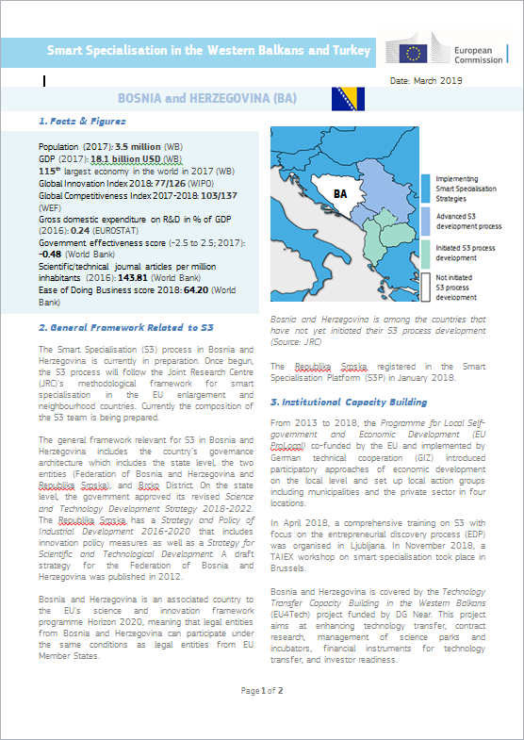
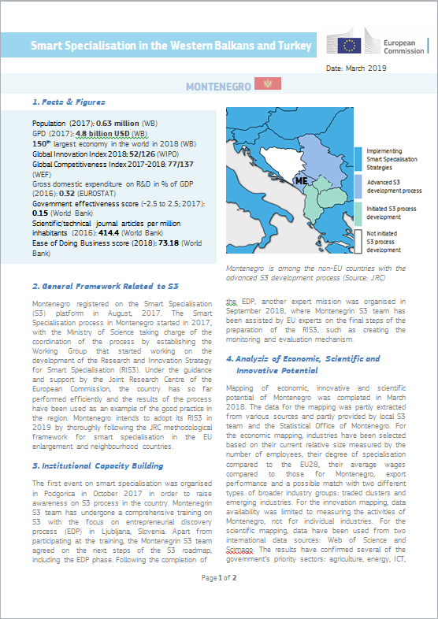
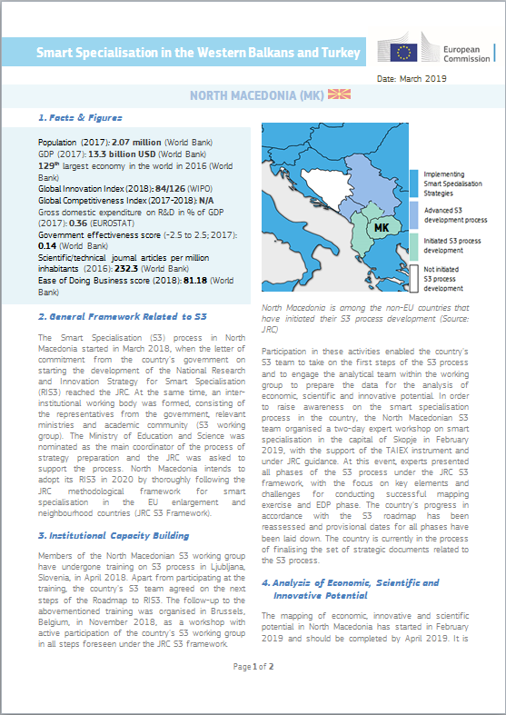
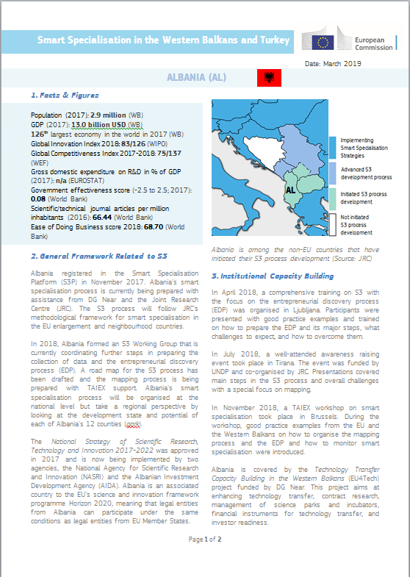
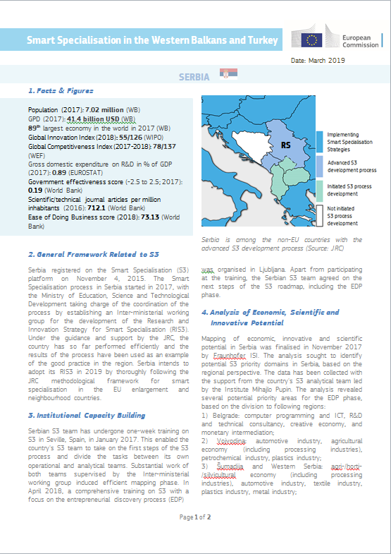
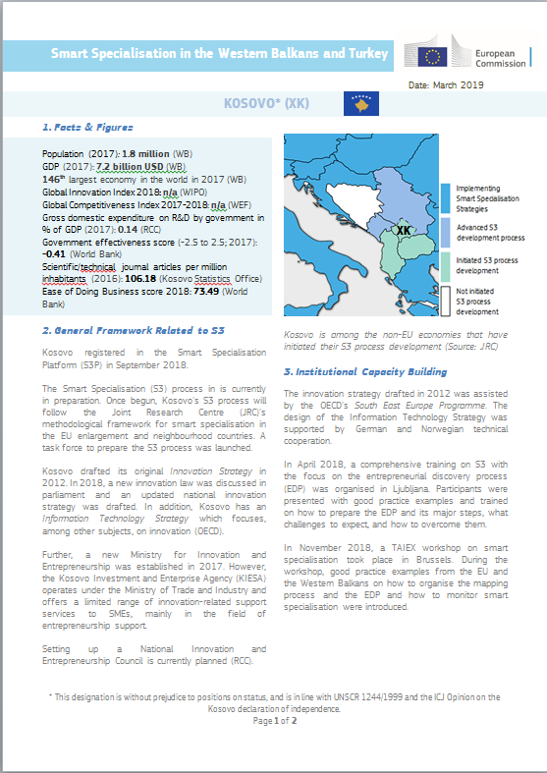
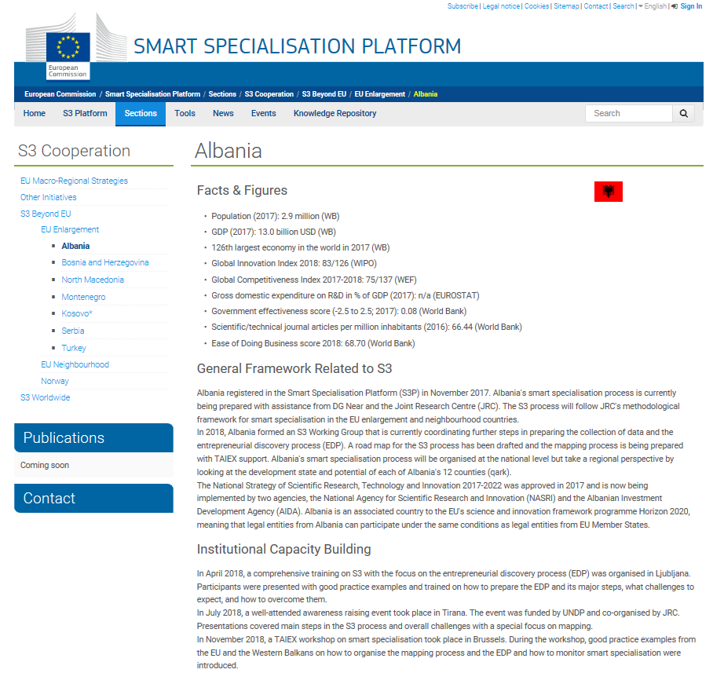
JRC S3 Enlargement countries' activities 2019
Country Fiches: Smart Specialisation in the Western Balkans and Turkey
Country Pages:
S3P-Website "EU Enlargement"

Slide 6
Upcoming activities 2019-2020 – through relevant programmes/cooperation frameworks
AA JRC w/DG NEAR July2019-June2022 focusing Enlargement countries:
Project's Kick-off 17 Oct. 2019 in Belgrade – WBC S3-country teams invited with reimbursement!
Aiming at Western Balkans and Turkey (with some potential spill-overs for Neighbourhood countries)
Trainings, targeted expert support at different levels of S3 development & support for R&I brokerage events for WB6 & Turkey
Numerous S3 related activities planned across the region – many started prior project start !
EU Macro-regional Strategies Annual Forums and Events with WBC (Danube, Adriatic-Ionian)
+ Travel, Accommodation and Conference Facility (TAC) - IPA funding for meetings/conferences involving candidate countries and potential candidates.
+ TAIEX (Technical Assistance and Information Exchange instrument of the EC)

Slide 7
Thanks for your Attention!
Any questions?
You can find us at http://s3platform.jrc.ec.europa.eu/home
Ales.GNAMUS@ec.europa.eu

