Slide 1
INCO-NET for the Danube Region Support to the Western Balkans
Steering Platform on Research for the Western Balkan countries
Budapest, 9 June 2015
Elke Dall, Centre for Social Innovation

Slide 2
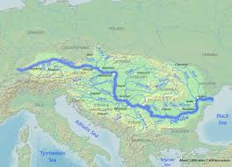
Danube-INCO.NET uses an inclusive geographical definition
Only few topics are directly related to the “physical” Danube
Working on horizontal issues, it is easy to implement variable geometry
Based on interest activities are open

Slide 3
One information platform for …
… news, events, calls (for proposals, for funding), documents, organisations, etc.
Creating a Platform – www.danube-inco.net – and a newsletter which improve the information exchange on Research and Innovation in the Danube Region (building on www.wbc-inco.net)
Synergies with wbc-rti.info which will be more focused on the region and looking more “in depth” on specific issues

Slide 4
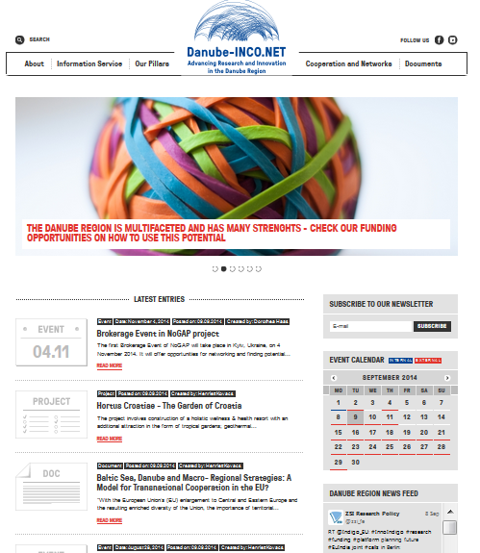
Also non “Danube” partners from WBC are invited to share information
Danube-INCO.NET PORTAL www.danube-inco.net
Danube-INCO.NET NEWSLETTER & Energy & Bioeconomy News alert
Danube-INCO.NET social media (Facebook, Twitter and LinkedIN)
Notes:
Danube-INCO.NET offers 2 main information means: Portal and NL - both provide reliable and up-to-date info on funding possibilities such as....You can consult the Portal on daily base or wait for our bi-weekly bulletins directly in your inbox
in about 7 month of activity 1,452 new information items were published on the portal. It means about 9.4 articles per working day.
monthly visits are steadily increasing and in 2014 were about 3000
>> 17 NL issues + 4 Energy and Bioeconomy NA sent
>> 12.388 registered NL users + 596 stakeholders receiving NA
newsletter recipients increased by 1507 in about 7 months
>> Facebook 629 fans reached – still a good trend yet >> Twitter, activity 374 tweets, 109 followers >> LinkedIN 100 members

Slide 5
Mapping of stakeholders
Danube-INCO.NET aims to support RI policy dialogue in the EUSDR PA SGs
The mapping of stakeholders relating to research and innovation aims to:
find complementarities
identify transferable good practices
formulate policy recommendations
support strategic decisions

Slide 6
Stakeholders under investigation
Target group of analysis
Stakeholders based in the Danube Region
Regional and/or transnational stakeholders
European Union (or related stakeholders)
Stakeholders at international level
Discussion on June 8, 2015 Budapest on
Synergies and overlaps between activities for WBC, Danube Region and Black Sea Area
Mapping of stakeholders and facilitation of discussions

Slide 7
Such as …
Danube Rectors Conference (DRC)
Danube Universities (DU)
Council of Danube Cities and Regions (CoDCR)
CLDR Romania
Danube Alliance
Danubiz
Danube Cluster Networks (DanuClus)
Young Danube Citizens Network (YDCN)
International Association for Danube Region (IAD)
Danube Chambers of Commerce Association (DCCA)
Ulm Follow-up Group
Steinbeis Danube Center
Ministerial Commissioner for EUSDR of Hungary
Danube Area Interregional Group at the Council of Regions
Black Sea - Danube Regional Network for Social & Economic Innovation
CEI Network of Focal Points on Science and Technology
CEI University Network (CEI UniNet)
Black Sea Economic Cooperation (BSEC)
CASEE
Regional Cooperation Council (RCC)
Southeast European Cooperative Initiative (SECI)
Central European Initiative (CEI)
South-East European Cooperation Process (SEECP)
Visegrad 4 Cooperation (V4)
Visegrad Fund
Central European Exchange Programme for University Studies (CEEPUS)
Western Balkans Research and Innovation Strategy Exercise (WISE) Facility
Vienna Economic Forum (VEF)
Salzburg Forum
Southeast Europe Investment Committee (SEEIC)
Central Europe Transnational Cooperation Programme
Southeast Europe → Danube Transnational Cooperation Programme
European Clusters Alliance
Entreprise Europe Network
United Nations Educational, Scientific and Cultural Organization (UNESCO)
Association of the European Chambers of Commerce and Industry (Eurochambers)
Association of Regional Development Agencies (EURADA)

Slide 8
Main areas to work with stakeholders
Reinforced Policy Dialogue among Stakeholders to Exploit Synergies and Achieve Mutual Goals
Enhanced Involvement of Stakeholders in the Implementation of EUSDR
Expanding Joint Programmes to Connect and Exploit the Potentials of the Region
Support to the RI Community
Strengthened Dialogue among the academia – industry – government

Slide 9
Most events are open to stakeholders
Smart Specialization peer reviews (IPTS) – upcoming event in Moldova in November 2015
Funding parties platform: next event September 22 in Vienna to discuss different options to implement joint funding
But yes, some activities are currently limited to the 14 EUSDR countries: Danube Transfer Centers, coordination of joint funding e.g. through EUREKA (next call in 2016 discussed in Lugano on June 30), labelling of projects on relevance for EUSDR, support to pilot projects for EUSDR implementation in the field of energy, etc.

Slide 10
Specific support to integration to the European Research Area strongly involves WBC
Integration to ERA, e.g. participation in H2020, focus SMEs (events in Belgrade and Kiev), development of background papers and policy recommendations (involved all non EU-MS)
Policy Mix Peer Reviews (BiH, Serbia) in preparation

Slide 11
Analysis (e.g. co-publications) as input to policy discussions involved DR+3

Slide 12
Co-publication Findings
Output patterns suggest three country groupings:
Austria, Czech Republic, Romania, Hungary and Ukraine (between 8,000 and 25,000 publications per year)
Serbia, Croatia, Slovenia, Slovakia, Bulgaria (1,000-8,000)
Bosnia and Herzegovina, FYR of Macedonia, Albania, Moldova, Montenegro (100-1,000)
Growth at all levels
Particularly strong growth pattern in Romania and Serbia
Relatively limited output growth in Hungary and Ukraine

Slide 13
Co-publication Findings
In general, the shares of internationally co-authored publications are between 40 % and 50 %
The general rule of a higher internationalisation of smaller research communities is confirmed
In most DR countries, the share of intra-DR co-publications in all international co-publications amounts to 40-50 %. These numbers are considerably higher in BiH and ME, and slightly higher for HR.
Little surprisingly, DE, AT, CZ and HU are the most important partners in most cases

Slide 14
Co-publication Findings
Comparing the thematic distribution of DR co-publications vs output allows the following observ.:
Relative strength of co-publications over publications:
Physics & astronomy
Chemistry
Biomedical research
Biology
Earth & environmental sciences
Relative weakness of co-publications over publications:
Engineering
ICTs

Slide 15
Co-publication Findings
Impact – country level:
each citable Danube region record covered in this study is cited on average 6.7 times. The countries with the highest average citation counts in their general output are¹:
Hungary: 9.16
Austria: 7.97
Slovenia: 7.55
DR collaboration country pairs with the highest impact (co-published output >250, 2003-2013):
country pair | avg. citations
RS-UA | 27.8
UA-HU | 26.8
CZ-HR | 24.7
HR-UA | 24.0
BG-HR | 23.6
CZ-HU | 23.5
DE-HR | 23.1
¹ Germany is not considered here as not all Germany records have been retrieved

Slide 16
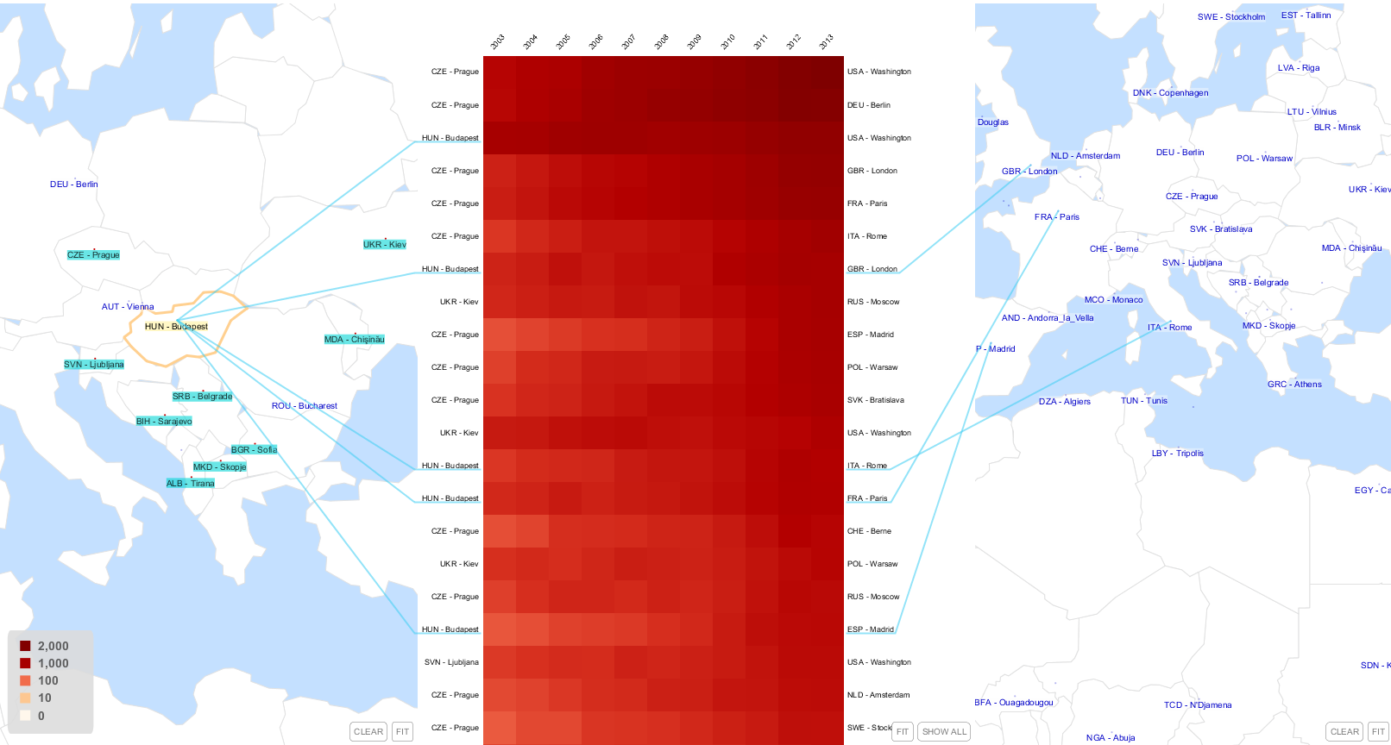
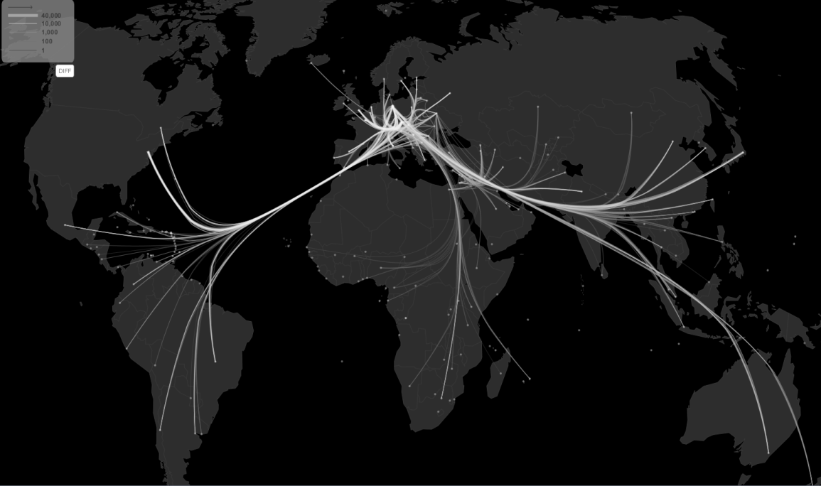
Next steps: Interactive visualisations

Slide 17
Co-patent Findings
Key concepts: When we speak of ‘patents’, we refer to patent applications (not granted patents) unless otherwise stated. There are two relevant types of collaborative patent applications:
(international) co-invention = a patent application filed by inventors from at least two different countries
foreign-owned inventions = a patent application with inventor(s) from one and applicant(s) from another country
As can be expected, the patent application output in the Danube region varies considerably. For the 2003-2013 period:
>700,000 applications from inventors in DE
>10,000 applications from inventors in AT, CZ, UA
>1,000 applications from inventors in BG, HR, HU, MD, RO, RS, SI, SK
<250 applications with inventors from: AL, BA, ME, MK

Slide 18
Co-patent Findings
Co-inventions (inventors from 2 or more DR countries)
Shares of co-inventions
Low share in DE (12.4 %) and SI (12.5 %)
High (>25 %) in Austria, Bulgaria and Slovakia
Very high (>50 %) in most smaller countries like AL, BA, MK
Strongest linkages
involve Germany and, in descending order: AT, CZ, HU, RO, SK, BG, UA, HR, SI
Excluding Germany, the strongest linkages are CZ-SK, MD-RO, AT-SK, MD-UA, AT-HU, AT-CZ, AT-SI
Application authorities:
BG-DE mostly apply to the US, DE-UA to Korea and Taiwan;
all others to DE and EPO

Slide 19
Co-invention shares per DR country
Country | Applications with inventor from country x | International co-inventions | Share of co-inventions
AL | 37 | 28 | 75.7%
AT | 54,836 | 15,681 | 28.6%
BA | 244 | 136 | 55.7%
BG | 2,894 | 890 | 30.8%
CZ | 12,174 | 2,979 | 24.5%
DE | 901,117 | 111,408 | 12.4%
HR | 3,008 | 518 | 17.2%
HU | 9,913 | 2,526 | 25.5%
MD | 2,954 | 423 | 14.3%
ME | 51 | 17 | 33.3%
MK | 130 | 88 | 67.7%
RO | 8,262 | 1,983 | 24.0%
RS | 2,023 | 452 | 22.3%
SI | 5,196 | 651 | 12.5%
SK | 3,138 | 1,095 | 34.9%
UA | 18,077 | 2,863 | 15.8%

Slide 20
Co-patent Findings
Co-inventions - topics
Strongest topics (CPC-1 classes) in DR co-inventions:
Electricity; “Operations and Transport”; “Chemistry and Metallurgy”
Additional relative strengths
Mechanical engin.: CZ-DE, HU-DE, HR-DE
Chemistry and metallurgy: CZ-SK
Human necessities: DE-SI, AT-CZ, AT-SI, AT-SK
Physics: BG-DE
Emerging cross-sect technologies: DE-UA, CZ-DE

Slide 21
Co-patent Findings
Foreign ownership
Share of foreign-owned patent applications (applications with an inventor from country x and NO applicant from x as a share of all applications with inventors from country x)
very high (>75 %) in some small countries: AL, BA, MK
high (>30 %): AT, SK
relatively low (<20 %): CZ, HR
low (<15 %): DE, SI, UA
very low (<5 %): MD
Strongest linkages within the DR (descending order)
AT→DE, DE→AT,
HU/CZ/RO/SI/BG/SK/UA→DE,
SK→CZ, DE→CZ, HR→DE, RO→MD, HU→AT, DE→HU

Slide 22
Analysis of barriers
Personal barriers
Administrative and bureaucratic barriers
Barriers related to Institutional support
Barriers related to overall capacity of country
Scientific excellence barriers
Socio-cultural and political barriers
Project management barriers
N=720

Slide 25
1 = no experience at all to 5 = lots of experience

Slide 26
from 1 = very difficult to participate to 5 = very easy to participate

Slide 27
Overcoming barriers
The most valued activities to overcome barriers among these countries are:
Mobility schemes to visit research organisations ad hoc to discuss and prepare joint proposals
Professional National Contact Point system informing potential applicants about funding opportunities
“twinning” schemes (cooperation with a similar organization in terms of research agendas, research management, etc.)
Participation in scientific conferences

Slide 28
Analysis of transferability of previous project’s results
Number of analysed projects per area
AREA / Project | SEE | CE | FP7 | CIP | TOTAL
Cluster development | 4 | 9 | 20 | 1 | 34
Technology transfer | 15 | 14 | 26 | 4 | 59
Financing tools | 3 | 3 | 3 | 0 | 9
Non-financing tools | 12 | 15 | 13 | 3 | 42
TOTAL PROJECTS | 18 | 21 | 32 | 4 | 75
TOTAL REsults | 46 | 92 | 130 | 6 | 274

Slide 29
Examples: Cluster development
New Cluster Concepts for Central Europe (Report/Study) CluStrat (CE)
Joint Strategy based on three founding concepts: clusters, emerging industries (active ageing, green economy, and sustainable mobility), and cross-cutting issues (knowledge transfer and knowledge co-production, internationalisation, and gender and innovation including diversity).
Handbook on transnational clustering (Methodology) CNCB (CE)
The document contains concrete recommendation and action plan worked out for clusters that wish to go international. In the recommendation for development and actions, special attention is paid to the theoretical and practical side of cluster portfolio making.

Slide 30
Examples: Technology transfer
Patent Cost Calculator (Methodology/Guidelines) FORT (CE)
Calculator provides information on estimated costs of patenting in direct national applications, EPO and PCT application.
Self-assessment tool for TT institutions (Methodology/Guidelines) CERIM (CE)
The self-assessment tool (SAT) is an organisational capacity assessment tool designed for the use by technology transfer institutions.

Slide 31
Get in touch
Reach us at office@danube-inco.net
Register for the newsletter
Join us on social media
Facebook
Twitter
LinkedIn

Slide 32
Thank you for your attention!
Elke Dall
Centre for Social Innovation
dall@zsi.at, www.zsi.at

